Slide 1







OVERALL CREEK
Tamara Cosby and Abbey Brown
5th Grade Science and Math

Slide 2


Redesignation = RESET
Question Driving
Intentionallity

Slide 3
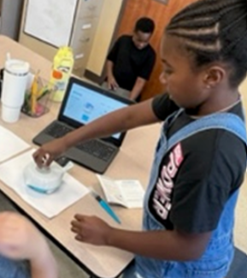
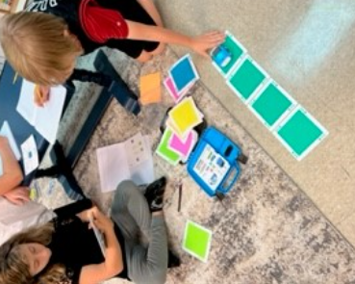
TECHNOLOGY= INTEGRATED

Slide 4
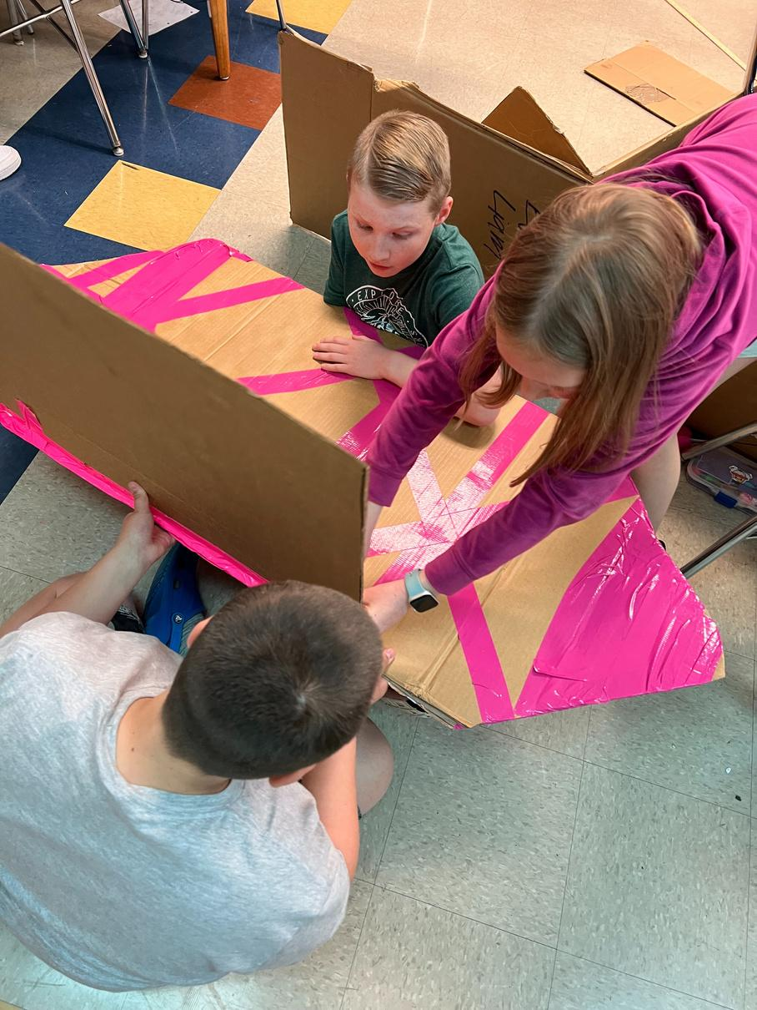
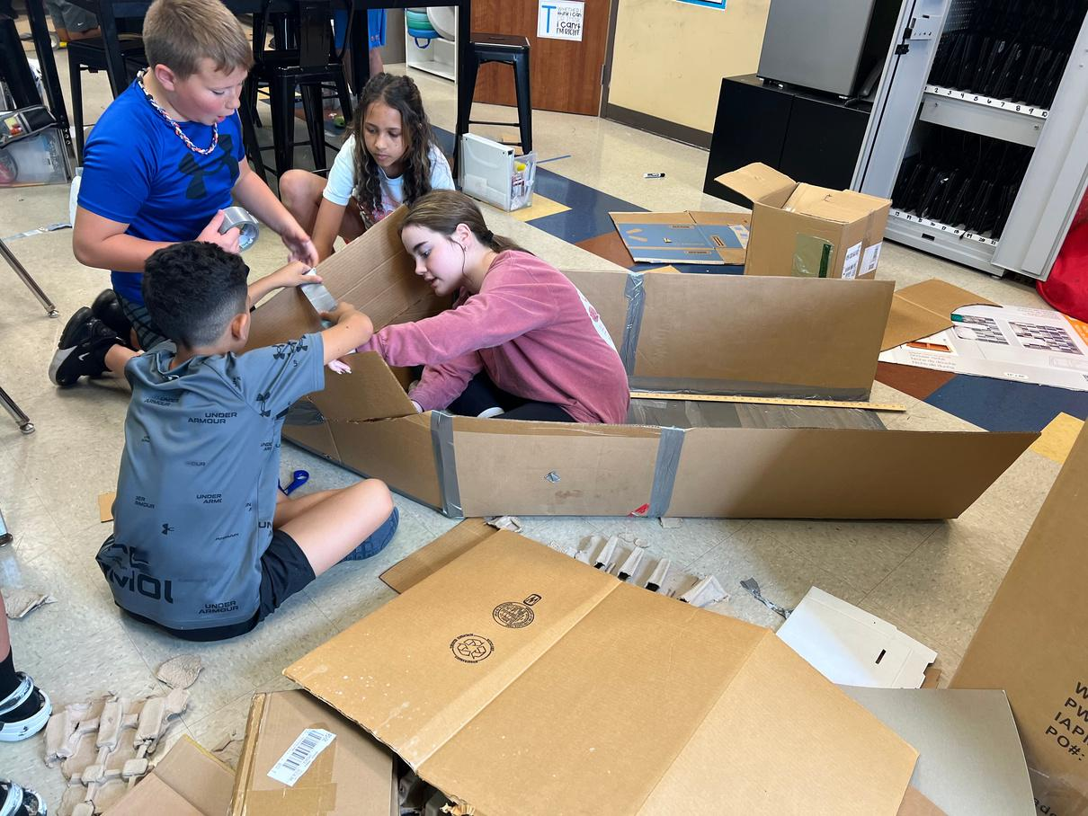
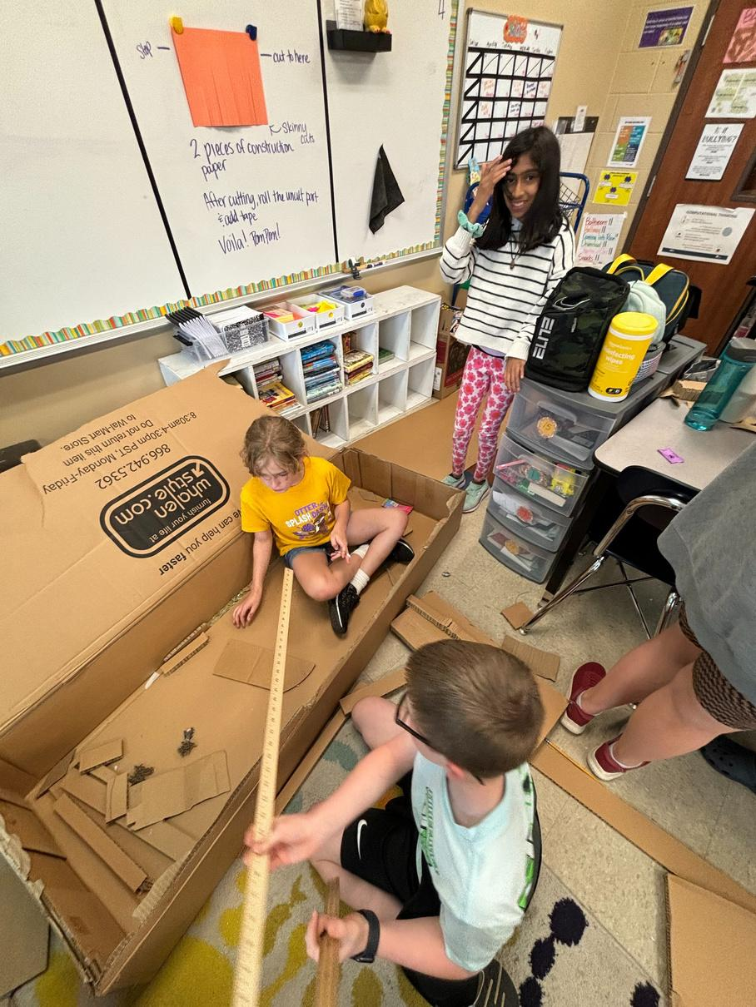
CURRICULUM = STILL STEAMING

Slide 5
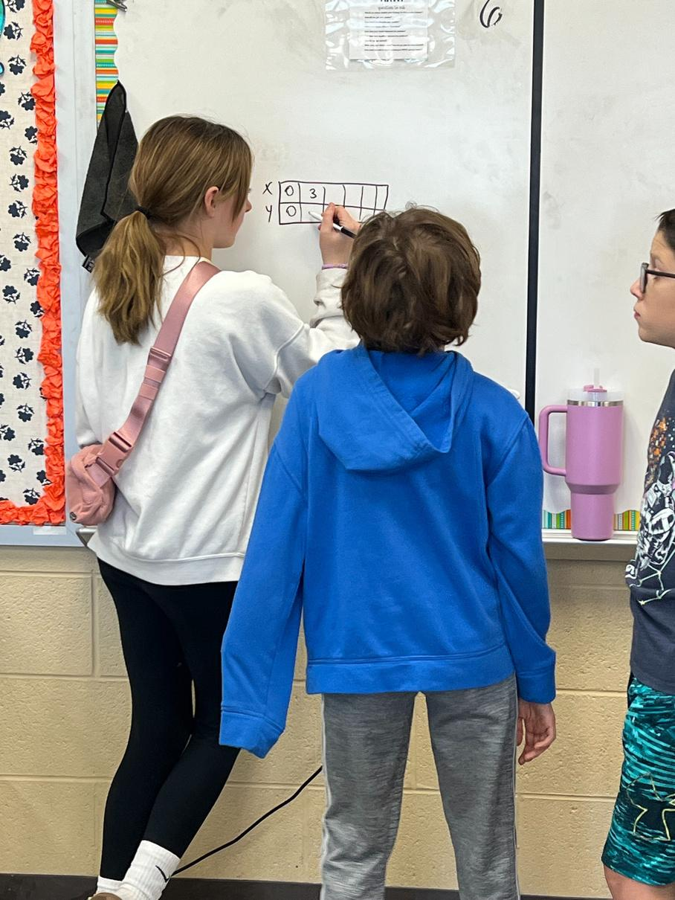
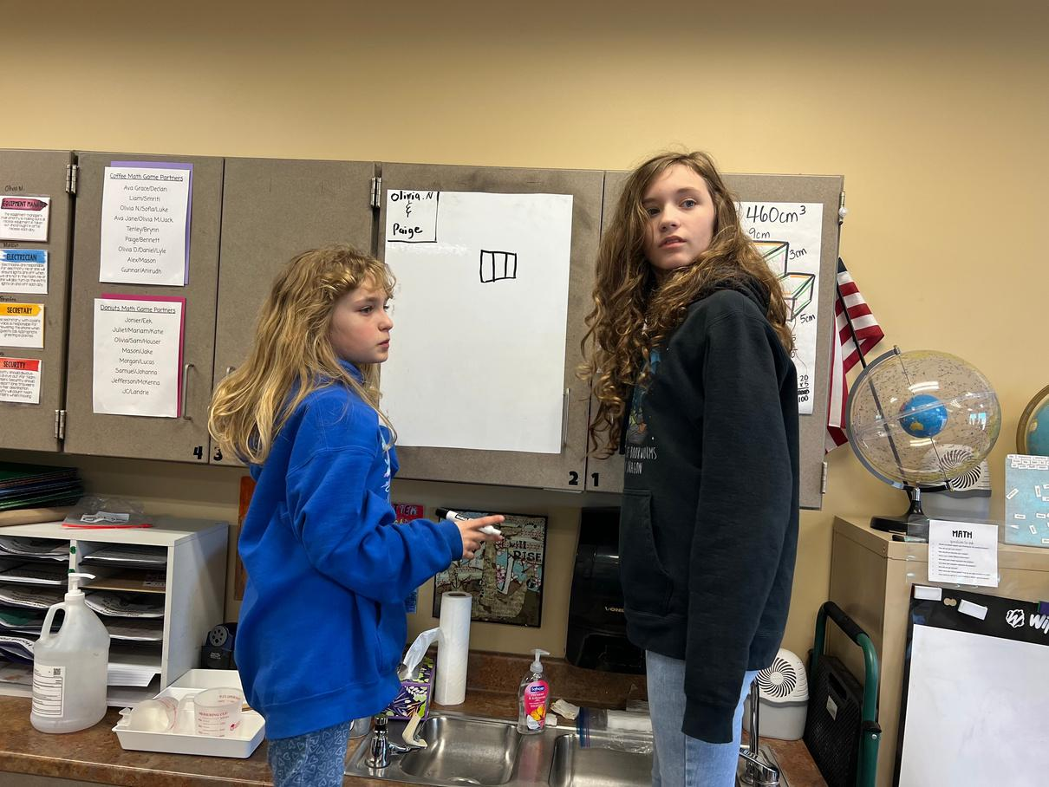
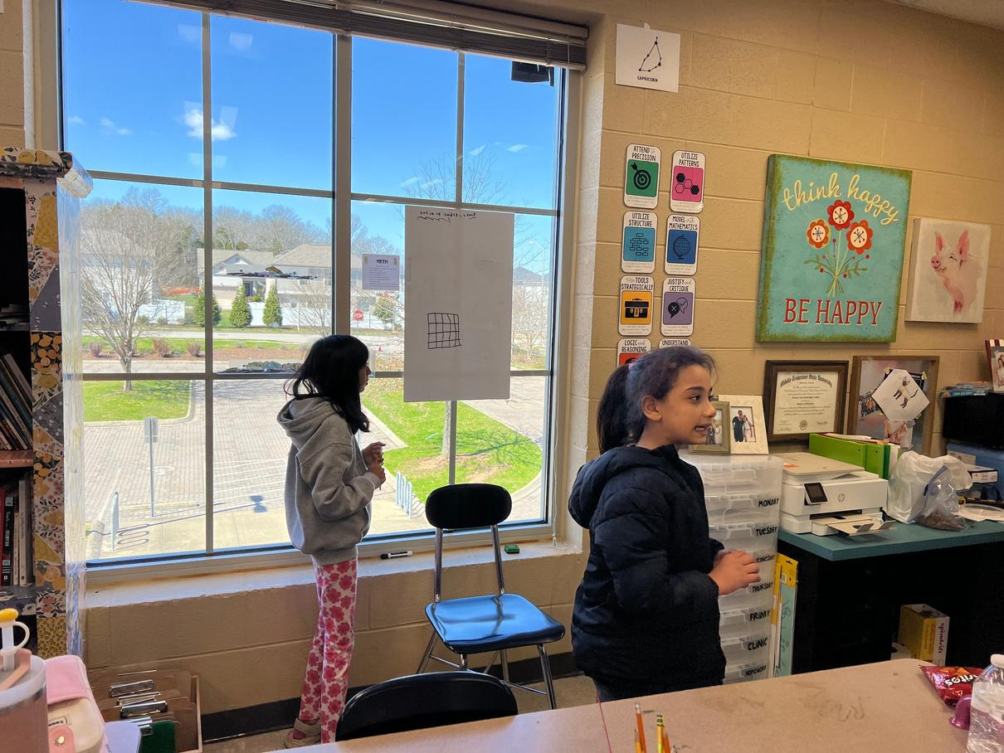
BUILDING THINKERS= ENGAGEMENT

